Slide 1

Usability Rules and Principles
User Experience

Slide 2
Rules and Principle's
Let’s focus on important usability issues, terms, rules and principles which are usually forgotten, ignored or misunderstood.
  7±2 Principle
  2-Second-Rule
  3-Click-Rule
  80/20 Rule (The Pareto principle)
  Eight Golden Rules of Interface Design – discussed more on next page
  Fitts’ Law
  Inverted Pyramid
  Satisficing

Slide 3
Eight Golden Rules of Interface Design
As a result of Interface Design Studies, Ben Shneiderman proposed a collection of principles that are derived heuristically from experience and applicable in most interactive systems. These principles are common for user interface design, and as such also for web design.
Strive for consistency.
Enable frequent users to use shortcuts.
Offer informative feedback.
Design dialog to yield closure.
Offer simple error handling.
Permit easy reversal of actions.
Provide the sense of control.
Reduce short-term memory load.

Slide 4
Psychology Behind Usability
Baby-Duck-Syndrome
Banner-Blindness
Cliffhanger-Effect (Zeigarnik-Effect)
Gestalt principles of form perception (to be reviewed later)
The Self-Reference Effect

Slide 5
9 Common Usability Mistakes
Tiny clickable areas
Pagination used for the wrong purpose
Duplicate page titles
Content that is difficult to scan
No way to get in touch
No way to search
Too much functionality that requires registration
Old permalinks pointing nowhere
Long registration forms

Slide 6
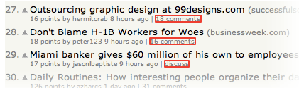
1. Tiny clickable areas example

Slide 7

2. Pagination used for the wrong purpose
https://www.wired.com/2008/03/gallery-google-logos/

Slide 8
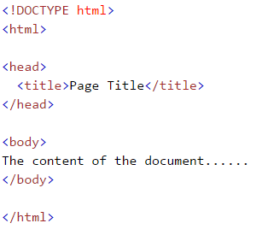
3. Duplicate page titles
IT Tallaght – search for computing course
Check Search Results
SEO

Slide 9
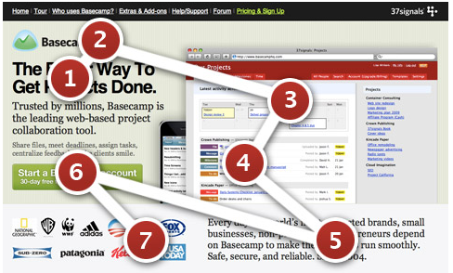
4. Content that is difficult to scan example
We scan the page. Something like this for example:

Slide 10

4. Content that is difficult to scan example

Slide 11
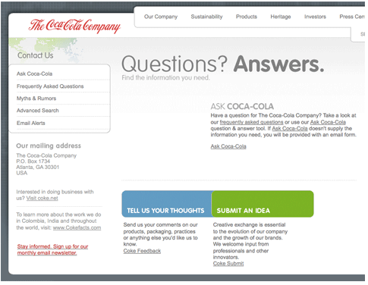
5. No way to get in touch
User engagement is also important if you want to build loyal customers
Some websites don’t even have an email address or contact form on them.

Slide 12
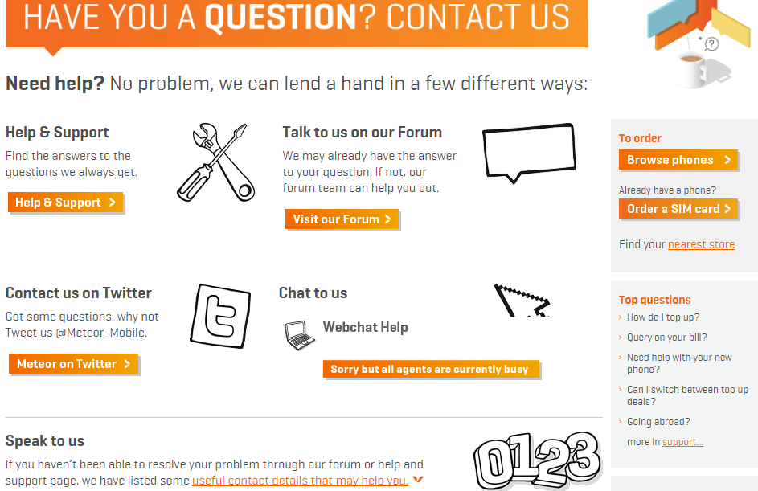
5. No way to get in touch

Slide 13
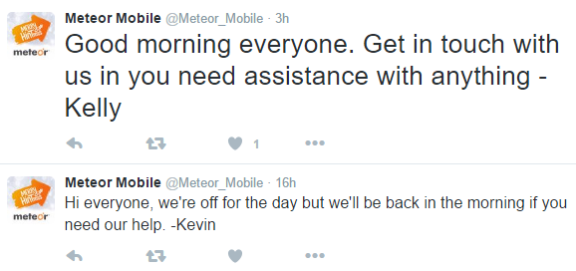

5. No way to get in touch

Slide 14
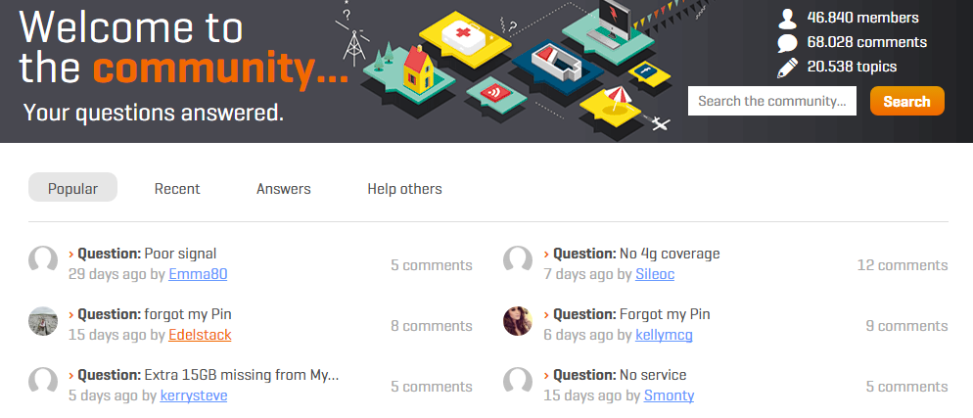
5. No way to get in touch

Slide 15
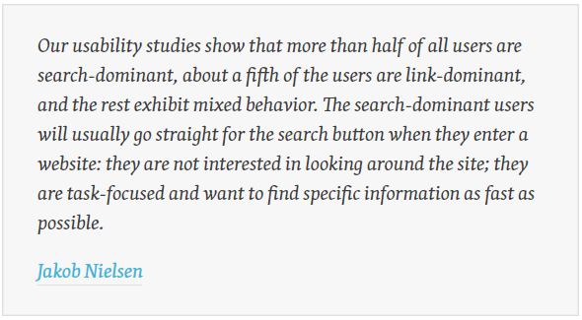
6. No way to search

Slide 16
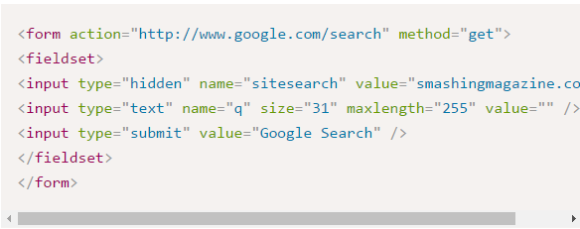
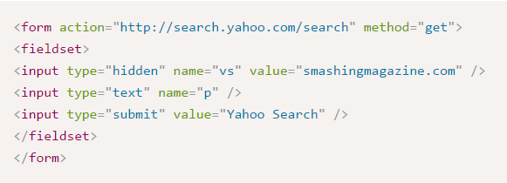
6. No way to search
You don’t need to create your own search functionality

Slide 17
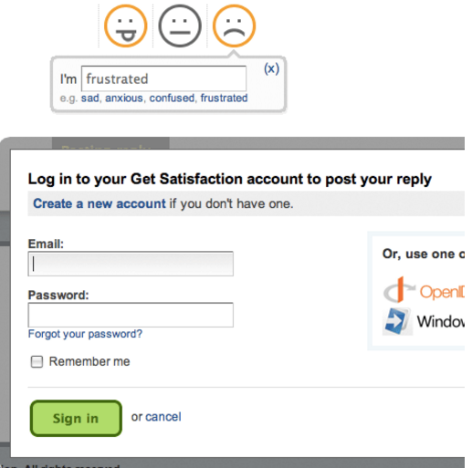
7. Too much functionality that requires registration
Users should not have to identify themselves to enjoy some functionality
User participation on your website is affected by how many barriers there are.
Once users start using your website, they will more likely sign up, because they’re already involved!
Across - posting comments
requires you to sign in.
Decreases spam but what else?

Slide 18
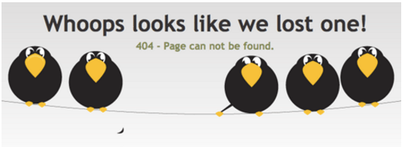

8. Old permalinks pointing nowhere

Slide 19
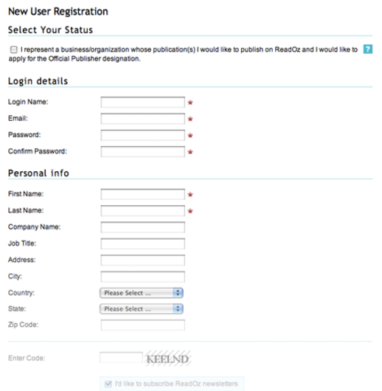
9. Long registration forms example

Slide 20
8 Usability Nightmares
Hidden log-in link.
Pop-ups for content presentation.
Invisible links.
Visual noise.
Dead end.
Content blocks layering upon each other.
Drop-Down Menus.
Blinking images

Slide 21
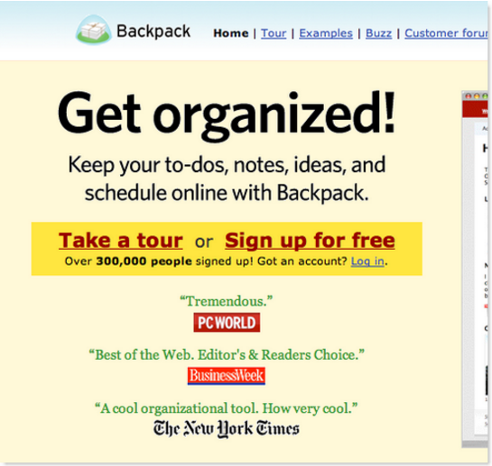
Hidden log-in link example

Slide 22
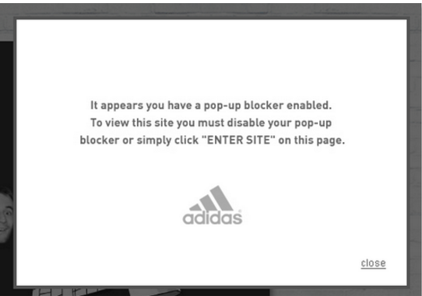
Pop-ups for content presentation example

Slide 23
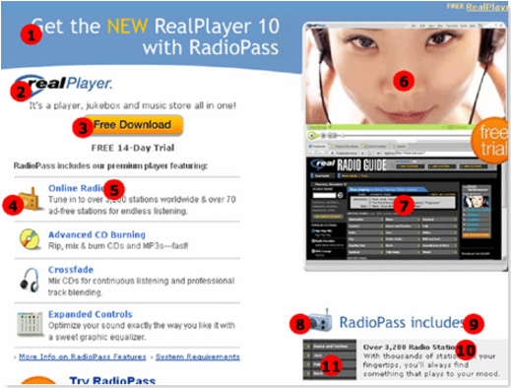
Invisible links example
Which of the 10 are links?
2, 5, 8, 9 and 10 are not

Slide 24
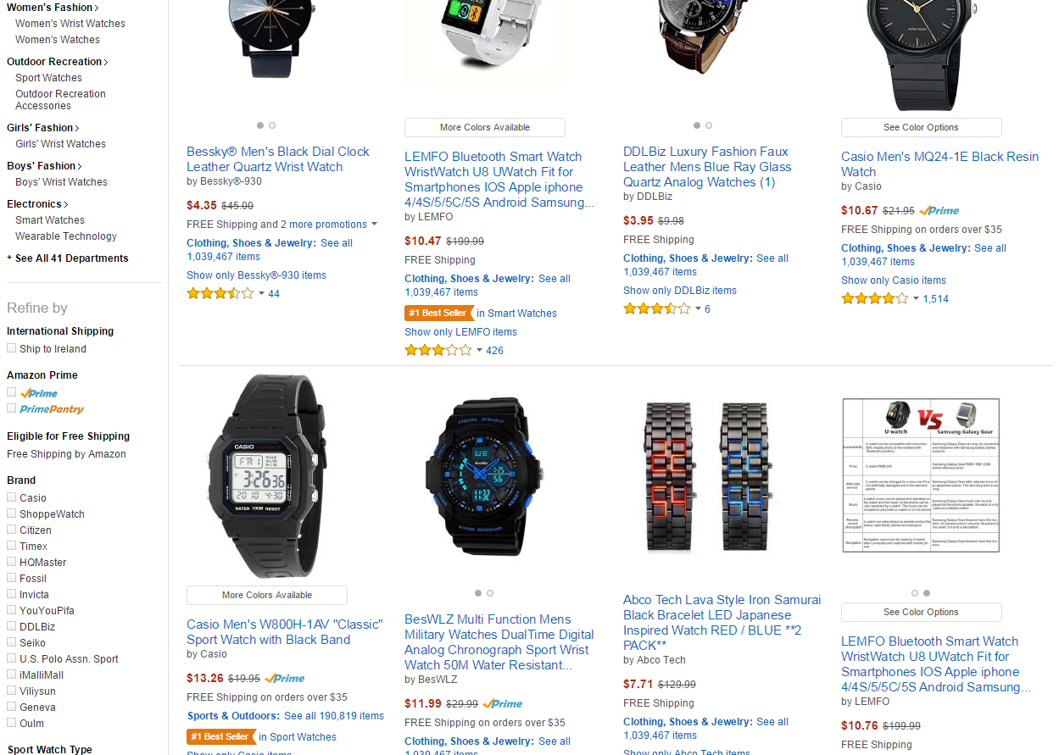
Visual noise example

Slide 25
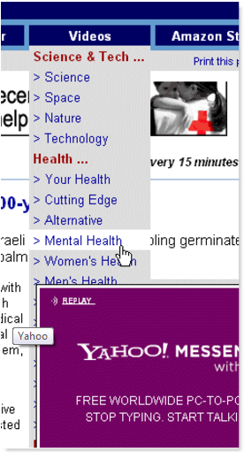
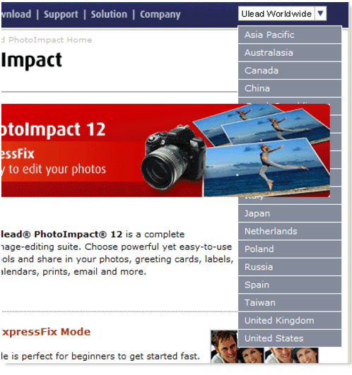
Content blocks layering upon each other example

Slide 26
Drop down menus example
See the difference
  https://www.brita.net/ie/
  http://www.amazon.com/
  http://www.microsoft.com/en-us/
  http://www.apple.com/

Slide 27
8 Usability Check-Points
You don’t use pop-ups.
You don’t change users’ window size.
You don’t use too small font sizes.
You don’t have unclear link text.
You don’t have dead links.
You have at most one animation per page.
You make it easy to contact you.
Your links open in the same window expect when you are going to a different site or presenting extra content such as a document etc

Slide 28
10 Usability Heuristics for User Interface Design
Jakob Nielsen identifies the 10 most general design principles for interaction design.
Visibility of system status
Match between system and the real world
User control and freedom
Consistency and standards
Error prevention
Recognition rather than recall
Flexibility and efficiency of use
Aesthetic and minimalist design
Help users recognize, diagnose, and recover from errors
Help and documentation

Slide 29
Task
Using a prototyping tool of your choice, design an app for IT Tallaght. The content of the app should focus on allowing the user get information about courses at IT Tallaght, in particular computing courses.
More prototyping tools
  https://moqups.com/
  https://www.fluidui.com/

Slide 30
References
Usability Issues To Be Aware Of
  http://uxdesign.smashingmagazine.com/2007/10/09/30-usability-issues-to-be-aware-of//
9 Common Usability Mistakes In Web Design
  http://www.smashingmagazine.com/2009/02/18/9-common-usability-blunders/
10 Usability Nightmares
  http://uxdesign.smashingmagazine.com/2007/09/27/10-usability-nightmares-you-should-be-aware-of
10 Usability Heuristics for User Interface Design
  http://www.nngroup.com/articles/ten-usability-heuristics/
Usability & User Experience
  http://www.smashingmagazine.com/usability-and-user-experience/

